Slide 1

Smart Shelves for Retail Stores
Presented
by
K Vasuki, 1RV14MCA42
Under the Guidance
of
Internal Guide External Guide
Anupama K Muthuumar
Date:25 Feb’2017 Department of MCA,RVCE 1 / 8

Slide 2
Agenda
Synopsis
Introduction
Literature Survey
H/W & S/W for Development
Training Details
Work Progress
References
Date:25 Feb’2017 Department of MCA,RVCE 2 / 8

Slide 3
Synopsis
Present the Details as per the Synopsis Details
Date Department of MCA,RVCE 3 / 8

Slide 4
Introduction
‘Out of Stock’ Challenge in Physical Stores
Dissatisfaction of the customers due to out of stock items in retail physical stores is one of the biggest current challenges the retail industry is currently facing.
Refill stocks from stock room as they get depleted from the store shelf
Intimate the buying group about the demand and Out of stock situation
Inform warehouse / Direct shipment vendor for immediate replenishment
How Smart Shelves in Physical Stores Work
Date Department of MCA,RVCE 4 / 8

Slide 5
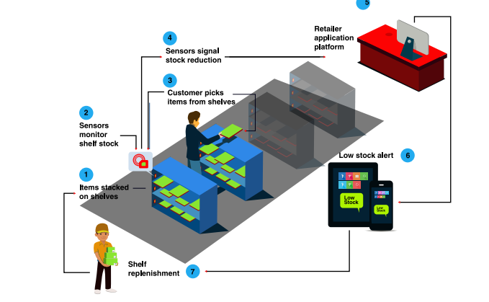

Slide 6
Features
Inventory Automation
Real time Inventory Management
Remote Monitoring Provision
Stock Availability Assessment
Hardware Compatibility
Business Benefits
• Reduction of ‘out-of-stock’ products
• Locate products easy and fast
• Better optimization of in-store operations
• Store space optimization
• Better utilization of in- store human resources • Increase in sales
• Control and monitor the usage of high value items
• Better analysis of product popularity
• Increase operational efficiency and store effectiveness
• Enhanced customer experience B

Slide 7
Literature Survey
Present Details about the learning / findings related to the project
Date Department of MCA,RVCE 5 / 8

Slide 8
H/W and S/W for development
Hardware
RFID tags
RFID readers
Antennas
Vonet Dongle
Beacons
Software
Net Beans 8.2
Node js
Mongo DB
Impinj

Slide 9
Training Details
1 week Sessions on nodejs and express framework
1 week training on basics of oracle jet and hands on
5 days training session on RFID tags, RFID readers,beacons and sensors
3 days event at Mercedes benz research and development to present IOT solutions.
End to and application development for 1 day oracle demo program.
Date Department of MCA,RVCE 6 / 8

Slide 10
Work Progress
Instructed to build a generic solution as base and use case at the end of next month
Data is collected from the readers and Rest API generated to push the data into database.
Data collection with RFID and Beacons accomplished.
UI for generic solution on process
40%of the project with respect to device layer is done.
30% of application layer is done.
Date Department of MCA,RVCE 7 / 8

Slide 11
Thank You
Date Department of MCA,RVCE 8/ 8

